Slide 1
35
The Short-Run Trade-Off between Inflation and Unemployment

Slide 2

Figure 1 The Phillips Curve
Inflation
Rate
(percent
per year)
6
B
2
A
Phillips curve
0
4
7
Unemployment
Rate (percent)
Copyright © 2004 South-Western

Slide 3
Figure 2 How the Phillips Curve is Related to Aggregate Demand and Aggregate Supply
(a) The Model of Aggregate Demand and Aggregate Supply
(b) The Phillips Curve
Price
Inflation
Level
Short-run
Rate
aggregate
(percent
supply
per year)
106
B
6
B
102
A
High
A
aggregate demand
2
Low aggregate
Phillips curve
demand
0
7,500
8,000
Quantity
0
4
7
Unemployment
(unemployment
(unemployment
of Output
(output is
(output is
Rate (percent)
is 7%)
is 4%)
8,000)
7,500)
Copyright © 2004 South-Western

Slide 4
Figure 3 The Long-Run Phillips Curve
Inflation
Rate
Long-run
Phillips curve
1. When the
High
B
central bank
inflation
increases
the growth rate
of the money
supply, the
rate of inflation
2. . . . but unemployment
increases . . .
Low
A
remains at its natural rate
inflation
in the long run.
0
Natural rate of
Unemployment
unemployment
Rate
Copyright © 2004 South-Western

Slide 5
Figure 4 How the Phillips Curve is Related to Aggregate Demand and Aggregate Supply
(a) The Model of Aggregate Demand and Aggregate Supply
(b) The Phillips Curve
Price
Long-run aggregate
Inflation
Long-run Phillips
Level
supply
Rate
curve
1. An increase in
3. . . . and
the money supply
increases the
B
increases aggregate
inflation rate . . .
P₂
demand . . .
B
2. . . . raises
the price
A
level . . .
P
AD₂
A
Aggregate
demand,
AD
0
Natural rate
Quantity
0
Natural rate of
Unemployment
of output
of Output
unemployment
Rate
4. . . . but leaves output and unemployment
at their natural rates.
Copyright © 2004 South-Western

Slide 6
Figure 5 How Expected Inflation Shifts the Short-Run Phillips Curve
2. . . . but in the long run, expected
inflation rises, and the short-run
Inflation
Phillips curve shifts to the right.
Rate
Long-run
Phillips curve
B
C
Short-run Phillips curve
with high expected
inflation
A
1. Expansionary policy moves
Short-run Phillips curve
the economy up along the
with low expected
short-run Phillips curve . . .
inflation
0
Natural rate of
Unemployment
unemployment
Rate
Copyright © 2004 South-Western

Slide 7
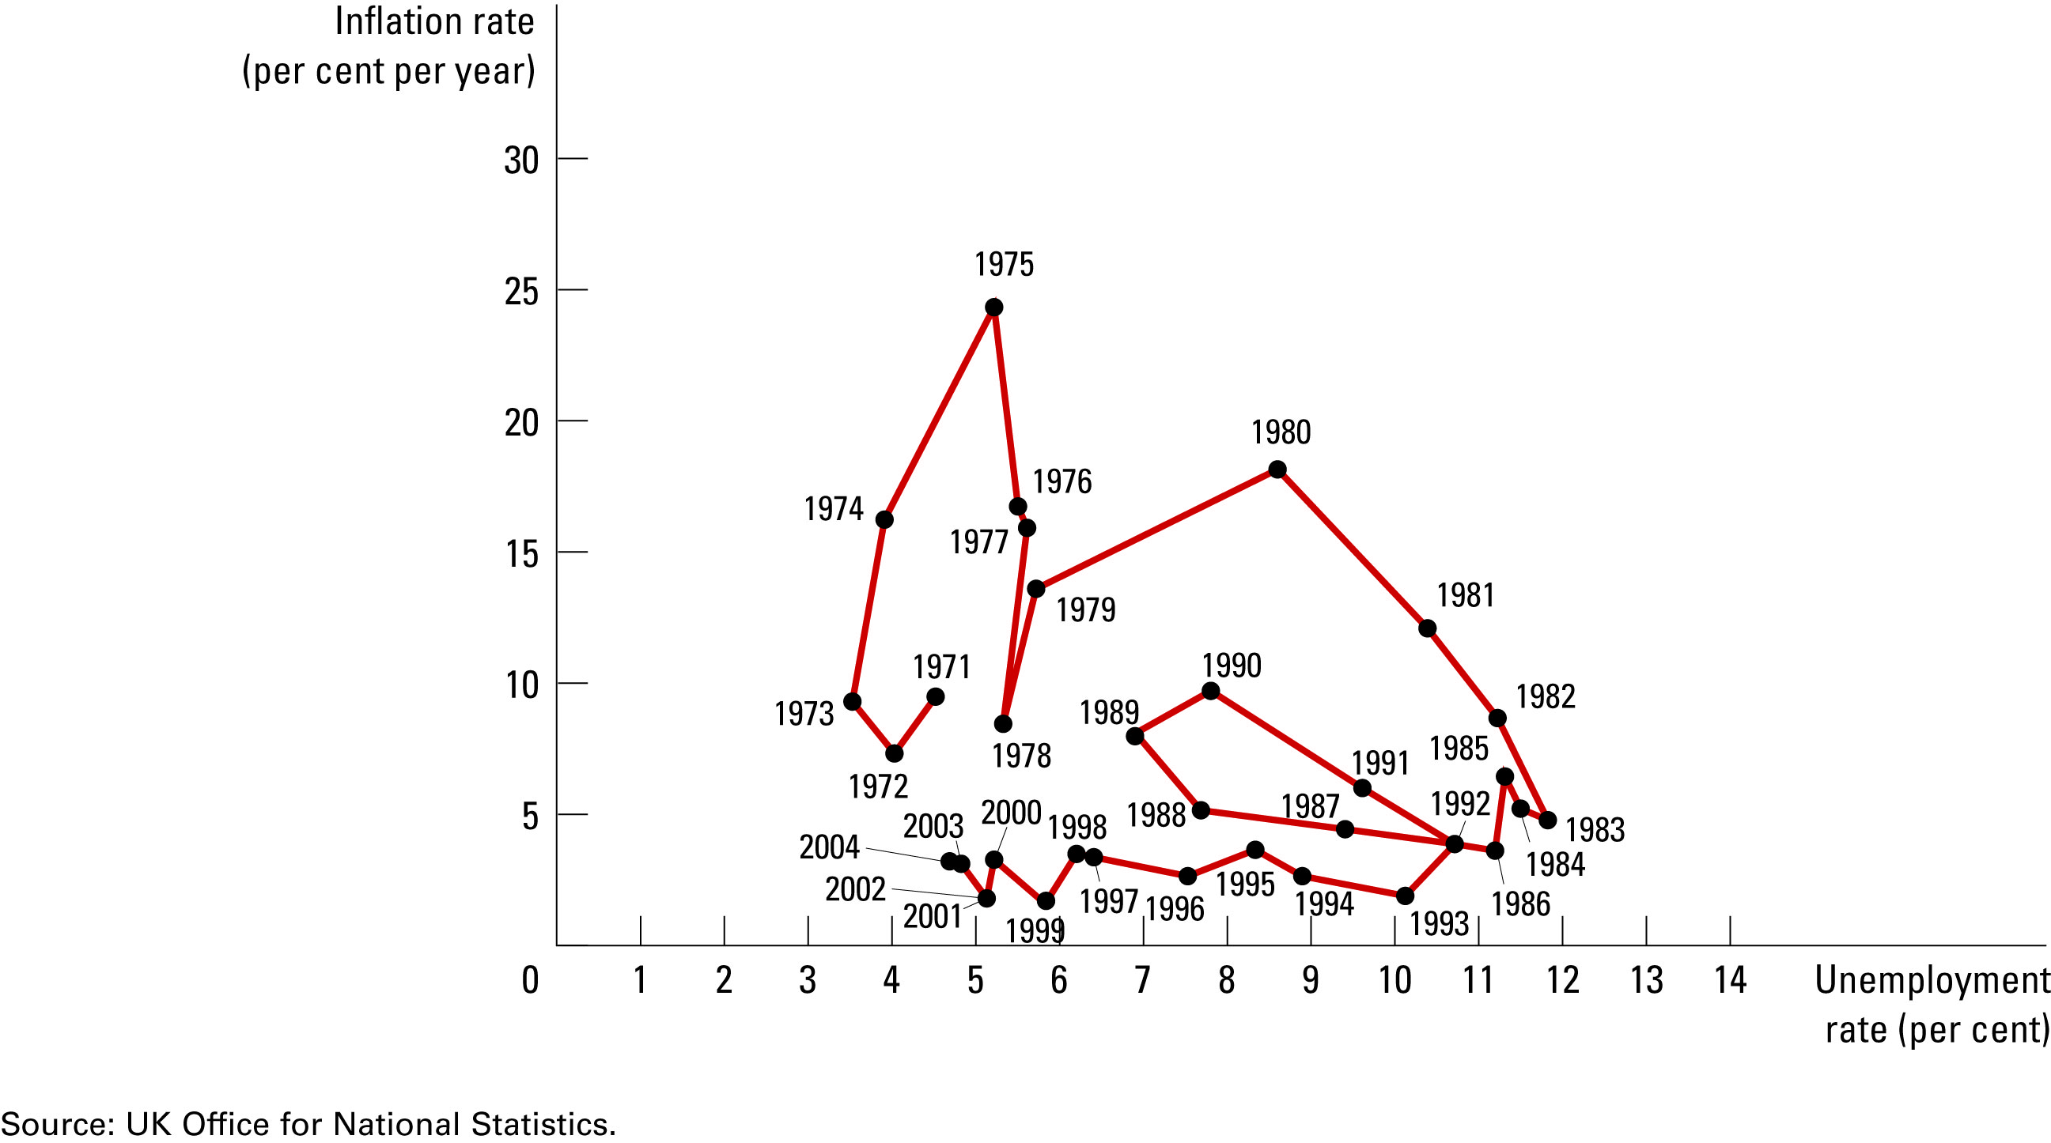
Figure 6 The Breakdown of the Phillips Curve
Copyright © 2004 South-Western

Slide 8
Figure 7 An Adverse Shock to Aggregate Supply
(a) The Model of Aggregate Demand and Aggregate Supply
(b) The Phillips Curve
Price
Inflation
4. . . . giving policymakers
Level
AS₂
Aggregate
Rate
a less favourable trade-off
supply,
AS
between unemployment
and inflation.
P₂
B
B
3. . . . and
1. An adverse
raises
A
shift in aggregate
A
the price
P
supply . . .
level . . .
PC₂
Aggregate
demand
Phillips curve,
P
C
0
Y₂
Y
Quantity
0
Unemployment
2. . . . lowers output . . .
of Output
Rate
Copyright © 2004 South-Western

Slide 9
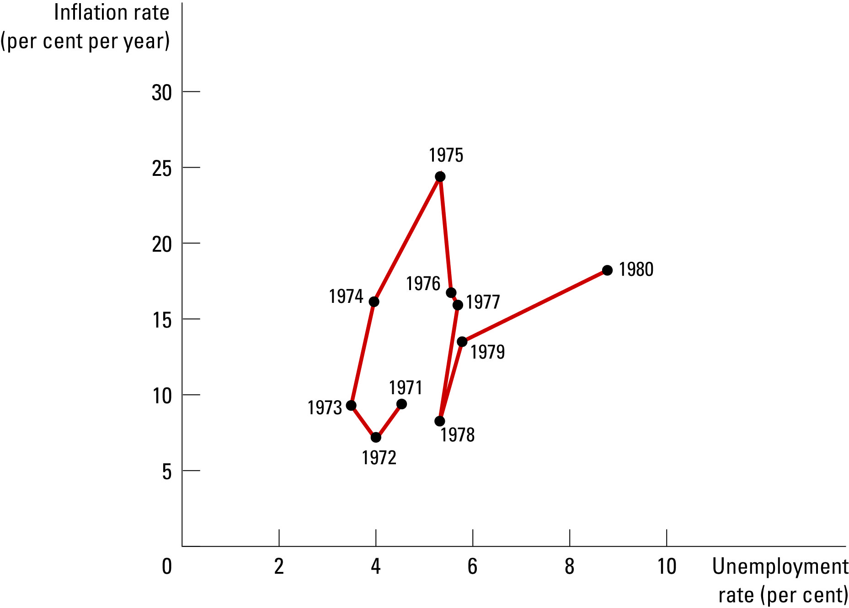
Figure 8 The Supply Shocks of the 1970s
Copyright © 2004 South-Western

Slide 10
Figure 9 Disinflationary Monetary Policy in the Short Run and the Long Run
1. Contractionary policy moves
the economy down along the
Inflation
Long-run
short-run Phillips curve . . .
Rate
Phillips curve
A
Short-run Phillips curve
with high expected
inflation
C
B
Short-run Phillips curve
with low expected
inflation
0
Natural rate of
Unemployment
unemployment
2. . . . but in the long run, expected
Rate
inflation falls, and the short-run
Phillips curve shifts to the left.
Copyright © 2004 South-Western

Slide 11
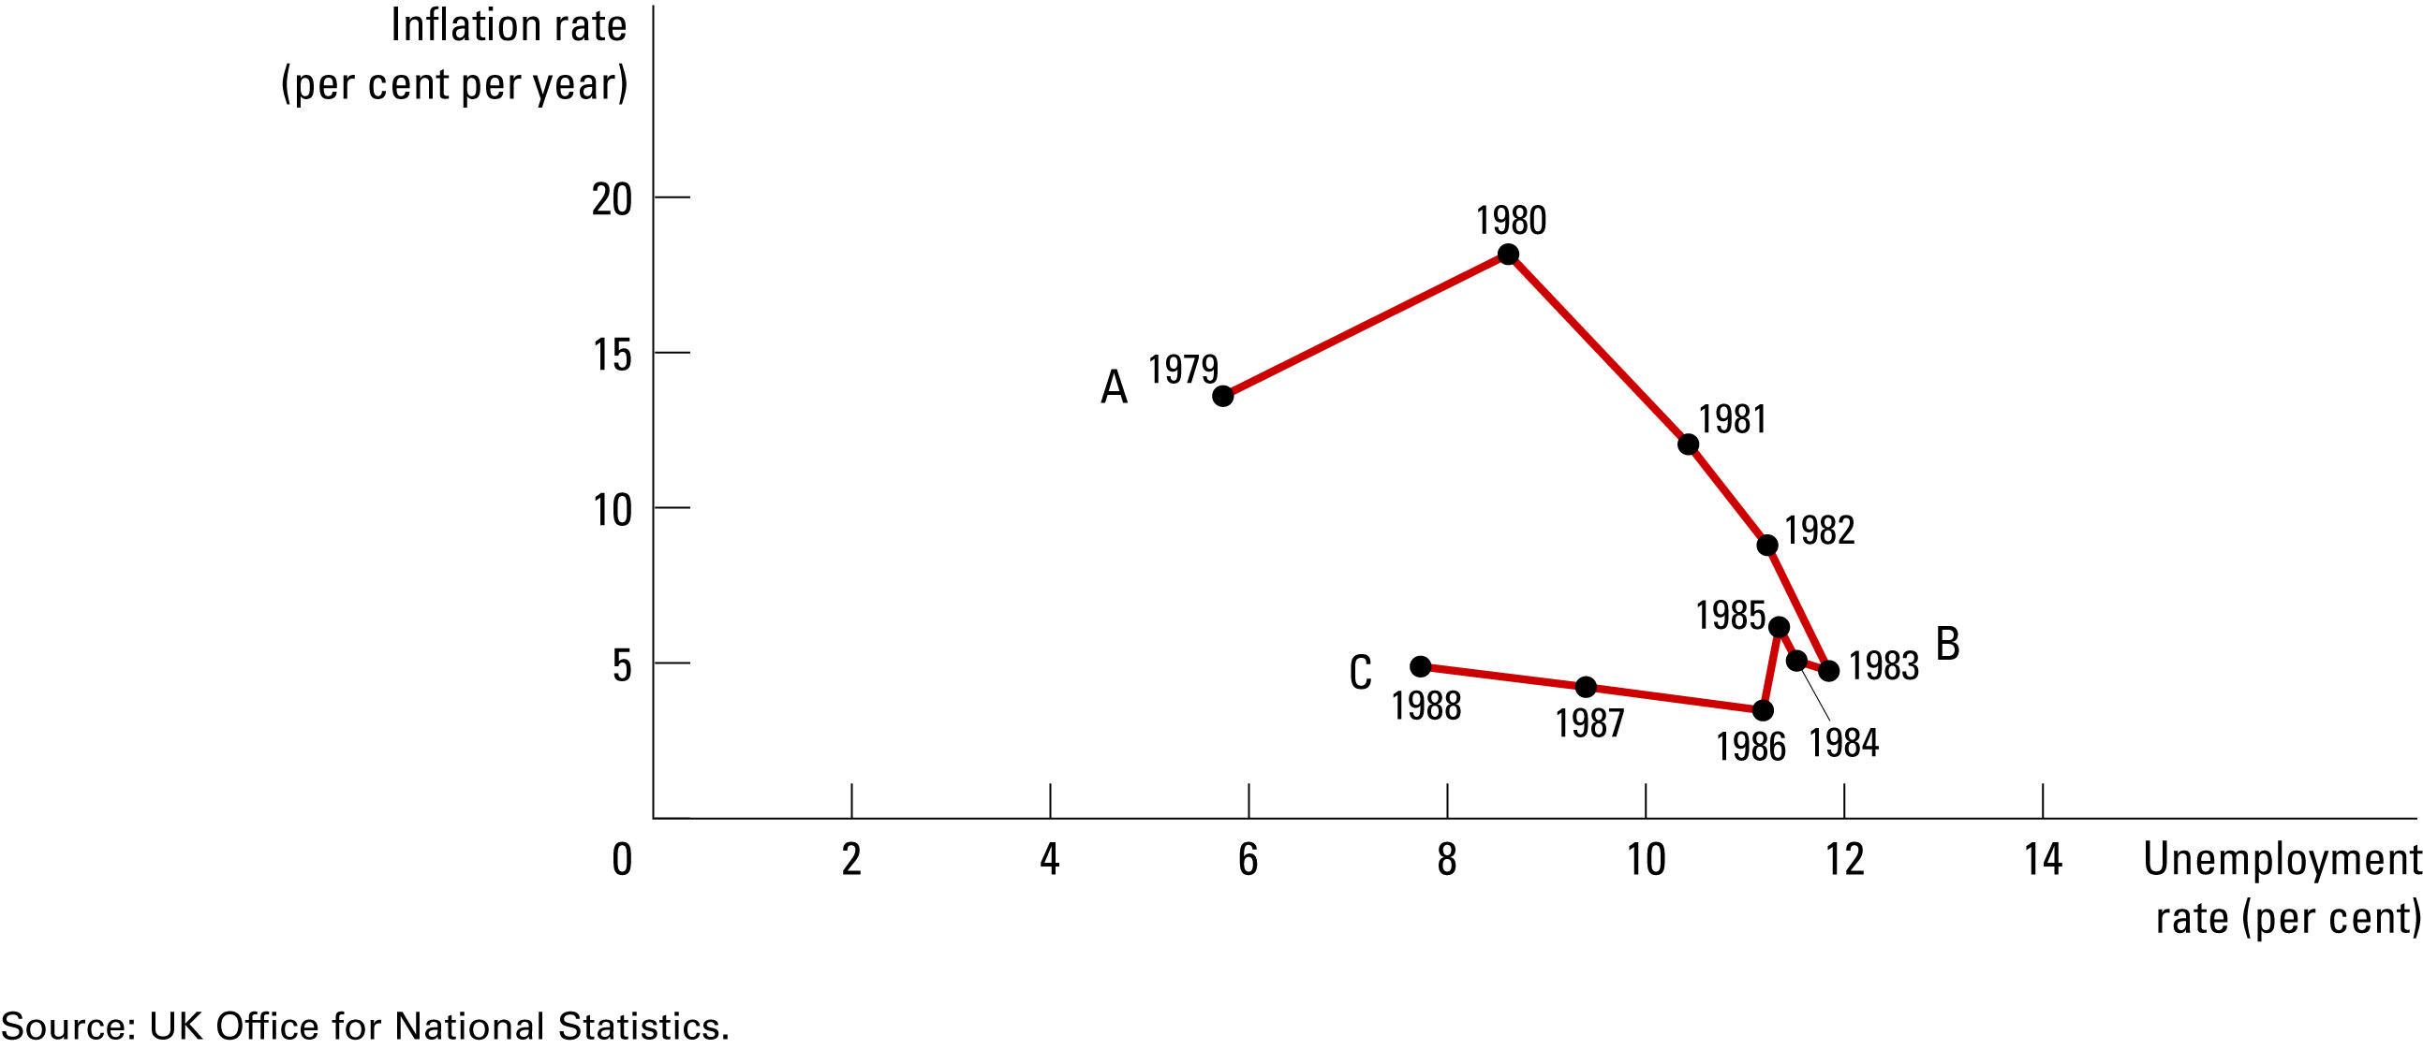
Figure 10 The Thatcher Disinflation
Copyright © 2004 South-Western

